Slide 1

DEPARTMENT OF INFORMATION SCIENCE & ENGINEERING
“SMART TRASH COLLECTOR USING IoT”
Presentation by,
Geetha b c
1NH16IS034
Under the Guidance of ,
Mr. Gangadhar Immadi
Sr. Assistant Professor

Slide 2
AGENDA
Introduction
Problem Definition
Proposed system
Objectives
Design modules
Implementation
Scope for Improvement
Conclusion

Slide 3
INTRODUCTION
We are living in an age where tasks and systems are fusing together with the power of IOT to have a more efficient system of working and to execute jobs quickly!
One of the main concerns with our environment has been solid waste management which impacts the health and environment of our society.
The detection, monitoring and management of wastes is one of the primary problems of the present era.
This is our IoT Garbage Monitoring system, an innovative way that will help to keep the cities clean and healthy.

Slide 4
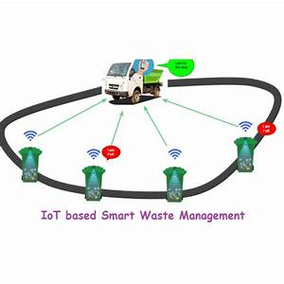
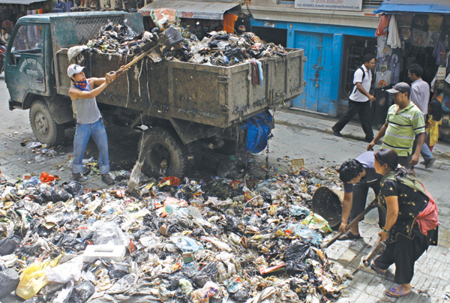
PROBLEM DEFINITION
The traditional way of manually monitoring the wastes in waste bins is a cumbersome process and utilizes more human effort, time and cost which can easily be avoided with our present technologies.

Slide 5
OBJECTIVES
The main objective of our project involves applying IoT technology to the current waste management scenario and enables a two way communication between the infrastructures deployed in the city and the operators/administrators.
In this way both the municipal and citizens benefit from an optimized system which results in major cost savings and less urban pollution.

Slide 6
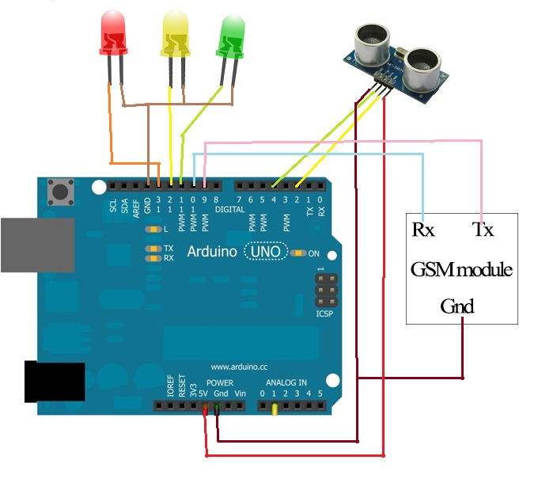
DESIGN MODULE

Slide 7
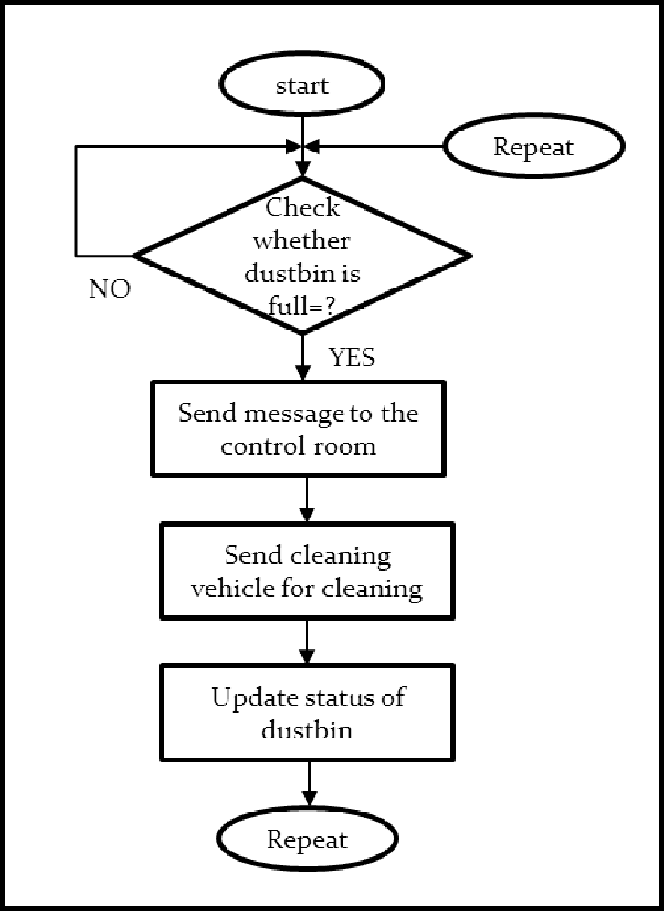
IMPLEMENTATION

Slide 8
SCOPE FOR IMPROVEMENT
Visualization effects.
Automated lid system.
Sensing type of the garbage.

Slide 9
CONCLUSION
By implementing this proposed system the cost reduction, resource optimization, effective usage of smart dustbins can be done.
System will inform the status of each and every dust bin in real time so that the concerned authority can send the garbage collection vehicle only when the dustbin is full.
With the help of this new proposed system we can able to avoid over flowing of garbage.

Slide 10
REFERENCES
www.wenglor.com
https://www.arduino.cc/
http://ijireeice.com
Ikuo Ihara; Nagaoka University of Technology; Ultrasonic Sensing: Fundamentals and Its Applications to Nondestructive Evaluation.

Slide 11
Thank you
Queries ?

